Slide 1

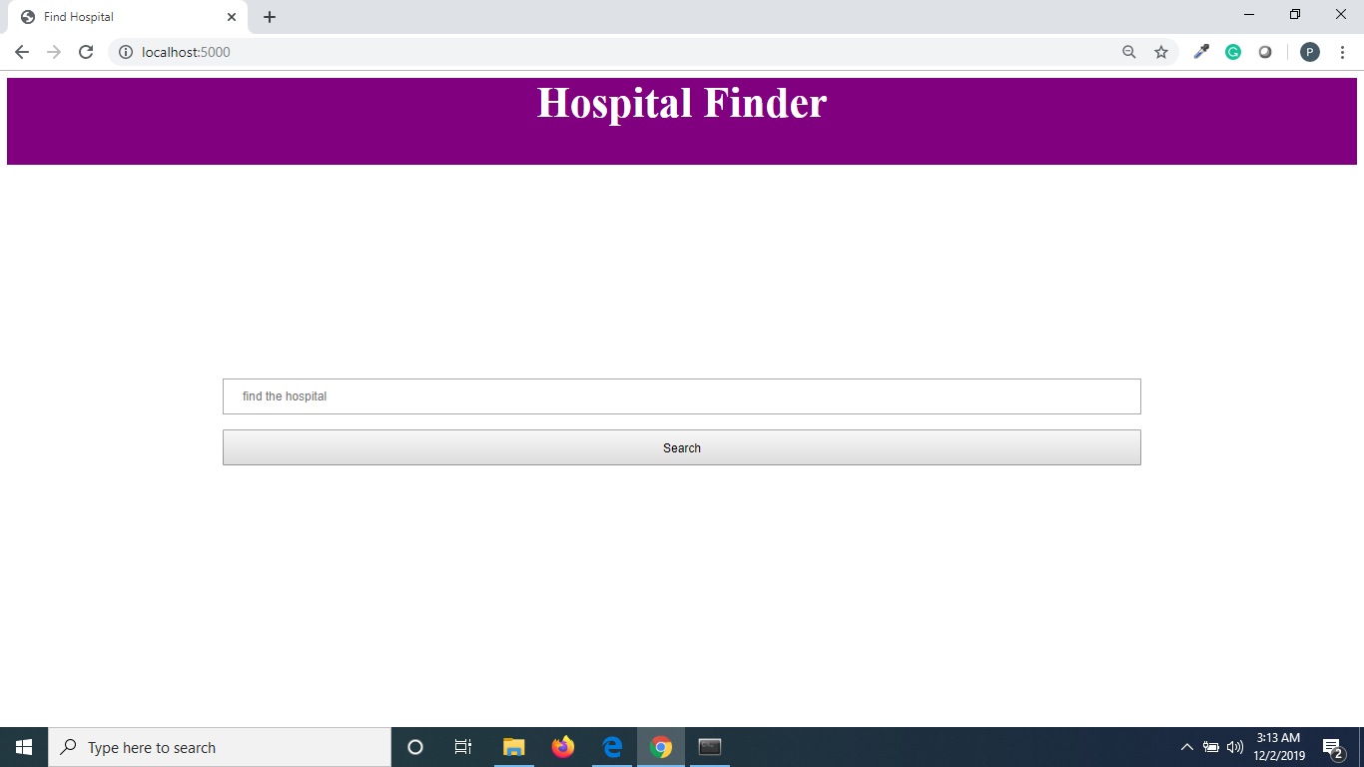
Hospital Finder
By:
Priyadarshni Sagar
ISTE 610 , Term Project

Slide 2
Outline
Project Demo
Database
Technologies used
Code snippets
Conclusion

Slide 3
Hospital finder is a web based application where user can search for a hospital by description

Slide 4
Database
MongoDB Atlas
Aws Server
DB_name: hospitals
Collections: data
: images

Slide 5
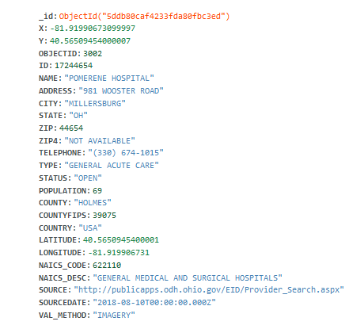
Data Collection:

Slide 6
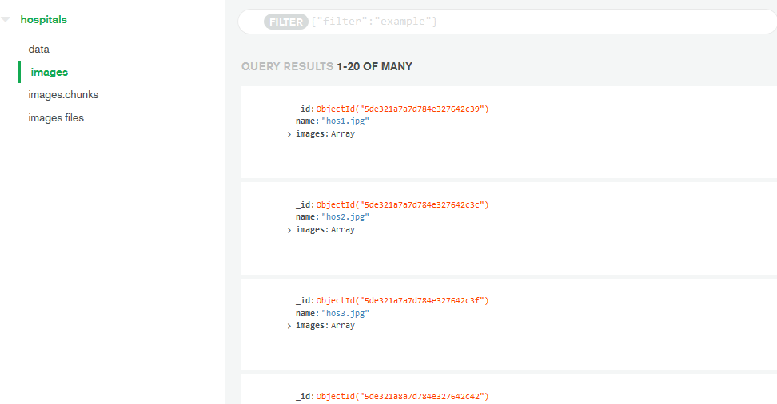
Images Collection:

Slide 7
Technologies Used:
MongoDB
Python Flask
GeoPy
PyMongo
GridFS
Html
Css
Python

Slide 8
Steps followed
Created database in MongoDB Atlas
Mongoimport to import the data
Inserted images in collection by gridfs
Connected to cluster from python
Developed application in flask

Slide 10
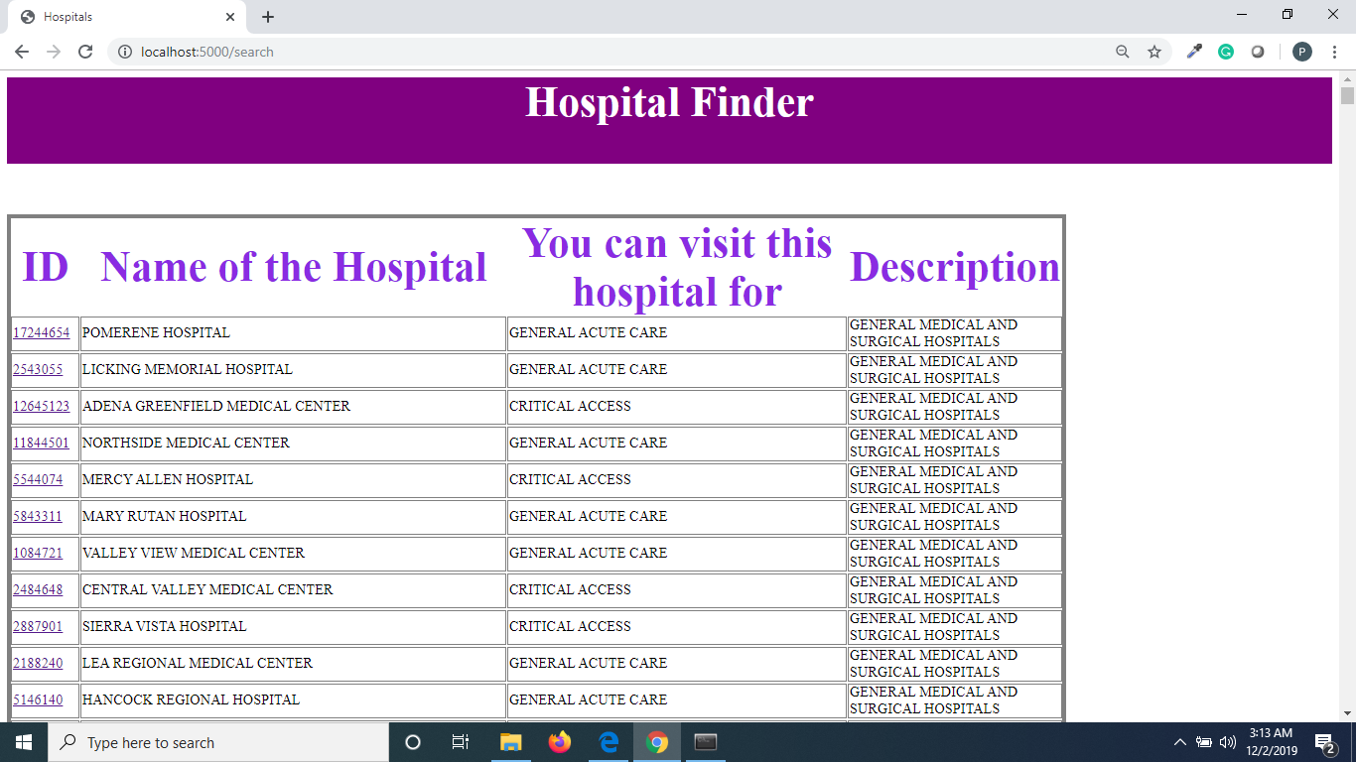

Slide 11
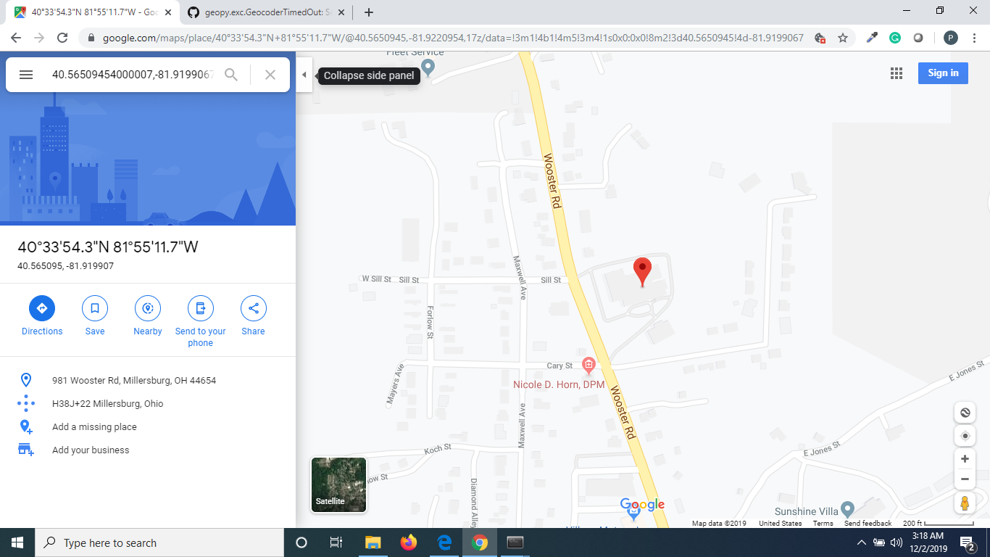

Slide 12
Questions?

Slide 13
References
https://api.mongodb.com/python/current/
https://www.palletsprojects.com/p/flask/
https://catalog.data.gov/dataset/hospitals-dcdfc

